Slide 1
Congruent triangles (RHS)
Geometrical properties: similarity and Pythagoras' theorem

Slide 2
how to use Oak lessons

Slide 3
I can appreciate and use the criteria by which triangles are congruent (RHS).

Slide 4
A right-angled triangle has exactly one 90° interior angle.
If one shape can fit exactly on top of another using rotation, reflection or translation, then the shapes are congruent.

Slide 5
The hypotenuse is the side of a right-angled triangle which is opposite the right angle.

Slide 6

Congruent triangles (RHS)
Finding the right angle
Justifying congruence by RHS

Slide 7
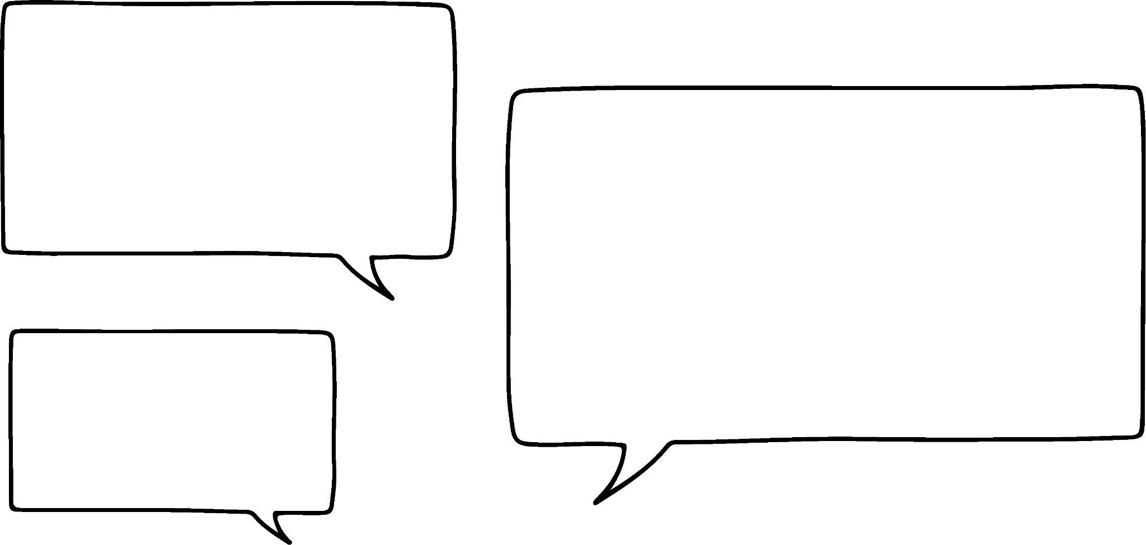

Finding the right angle
When two sides and an angle (not between them) are known, this can lead to two different triangles. For this reason, it is not sufficient enough to prove congruence between two triangles.
Does this information always lead to two different triangles?
5 cm
5 cm
50°
Alex
6 cm

Slide 8
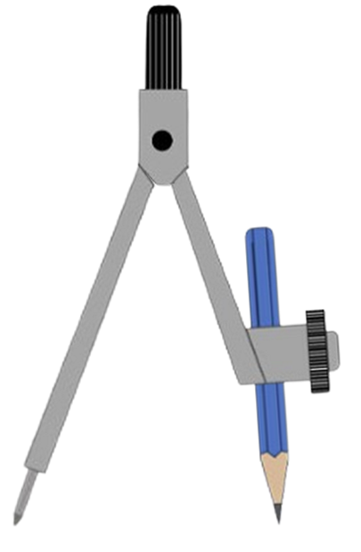
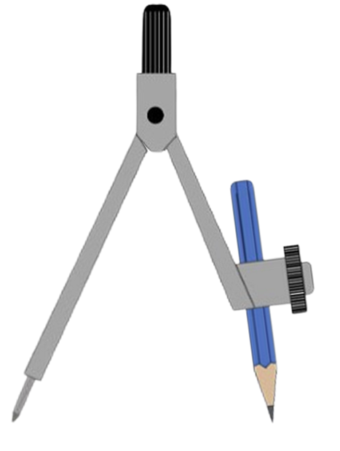
Finding the right angle
We will investigate Alex’s question, by keeping the angle and one edge the same and changing the second edge.
Vertex C will lie somewhere along the ray line.
We will start by increasing the length of the side opposite the known angle.
This still creates two triangles.
C₁
C₁
5.5 cm
5 cm
C₂
5.5 cm
5 cm
C₂
5 cm
5.5 cm
50°
50°
A
6 cm
B
A
6 cm
B
5.5 cm
5 cm
5.5 cm
5 cm

Slide 9
Finding the right angle
If an arc of radius 5.3 cm was to be drawn from B, how many times would it intersect with the ray line?
2 times
5.3 cm is less than 5.5 cm and more than 5 cm, which both intersected twice.
C₁
5.3 cm
C₂
5.3 cm
50°
5.3 cm
A
6 cm
B

Slide 10
Finding the right angle
So far, two triangles have been created.
If we increase the radius to 6 cm, does this change anything?
It means it will be an isosceles triangle.
C₁
The second point is the vertex A, so this does not create a triangle.
6 cm
6 cm
C₂
50°
Only one triangle is created.
A
6 cm
B

Slide 11
Finding the right angle
So far, two triangles have been created.
If we increase the radius to over 6 cm, what happens now?
C₁
6.6 cm
It only intersects with the ray at one point.
6.6 cm
50°
So only one triangle is created.
A
6 cm
B

Slide 12
Finding the right angle
What happens if our edge opposite the 50° angle is less than 5 cm?
We will start with 4 cm.
This will be the case for all lengths less than 4 cm.
It doesn’t intersect at all.
4 cm
50°
A
6 cm
B

Slide 13

Finding the right angle
In this construction, how many triangles will be there be?
0 triangles
1 triangle
5 cm
2 triangles
5 cm

Slide 14
Finding the right angle
The length of that radius is the minimum distance.
Anything less than it, will not intersect with the ray line.
We know that at 5 cm, it intersects twice and at 4 cm it doesn’t intersect at all. So there must be a length where it only touches the ray line at one point.
C₁
C
minimum length
5 cm
4 cm
C₂
5 cm
50°
A
6 cm
B

Slide 15
Finding the right angle
1) Using a pair of compasses, find and mark the location of vertex C, which makes the minimum length of BC.
A
a)
b)
c)
B
A
A
B
B
2) Use a protractor to measure angle BCA on each of the diagrams from question 1. What do you notice?

Slide 16
Finding the right angle
1) Using a pair of compasses, find and mark the location of vertex C, which makes the minimum length of BC.
A
a)
b)
c)
B
A
C
C
C
A
B
B
2) Use a protractor to measure angle BCA on each of the diagrams from question 1. What do you notice?
They are all 90°

Slide 17
Congruent triangles (RHS)
Finding the right angle
Justifying congruence by RHS

Slide 18
Justifying congruence by RHS
Here are two right-angled triangles.
A
F
20 cm
21 cm
D
E
B
C
21 cm
20 cm
From the given information, we can show that triangle ABC and triangle DEF are congruent. As AB = DE, ∠ABC = ∠DEF and BC = EF, they are congruent by SAS (side-angle-side).

Slide 19
Justifying congruence by RHS
If we were given this information instead, can we still be sure they are congruent?
A
F
29 cm
29 cm
20 cm
D
E
B
C
20 cm
Normally, having two side lengths and an angle which isn’t between them, is not sufficient to prove congruence, as there could be two different triangles.

Slide 20
Justifying congruence by RHS
If we were given this information instead, can we still be sure they are congruent?
A
F
29 cm
29 cm
20 cm
D
E
B
C
20 cm
However only one triangle is possible when a right-angled triangle is formed.

Slide 21
Justifying congruence by RHS
Consider placing a ladder against a wall on level ground.
The ladder is a fixed length.
The wall and ground are perpendicular to each other.
ladder
wall
If the foot of the ladder (bottom) is put 6 feet away from the wall.
How many different places will the top of the ladder touch on the wall?
ladder
6 ft
level ground
Only the one place. Only one right-angled triangle can be formed with those two sides with fixed lengths.

Slide 22
Justifying congruence by RHS
In a right-angled triangle, the 90° is the largest interior angle. The side opposite the right angle is also the longest edge.
It is called the hypotenuse.
hypotenuse
hypotenuse
hypotenuse

Slide 23
Justifying congruence by RHS
Which edge is the hypotenuse in this right-angled triangle?
a
b
c

Slide 24
Justifying congruence by RHS
The longest edge of a triangle is called the hypotenuse
The hypotenuse is the longest edge in a right-angled triangle
The longest edge is always opposite the largest angle

Slide 25
Justifying congruence by RHS
A special case of proving congruence by knowing two sides and an angle holds for right-angled triangles.
We know it as RHS (right angle-hypotenuse-side).
C
M
17 m
17 m
15 m
A
B
15 m
N
O

Slide 26
Justifying congruence by RHS
We know it as RHS (right angle-hypotenuse-side).
Triangle ABC and triangle MNO are congruent. What is the length of BC?
12 cm
M
C
35 cm
35 cm
A
B
N
O
12 cm

Slide 27
Justifying congruence by RHS
Are these two triangles congruent?
K
C
21 cm
29 cm
46°
44°
A
B
29 cm
I
J
21 cm
At first glance, none of the criteria for congruence apply.
∠ACB can be calculated using the sum of interior angles in a triangle. ∠ACB = 180 - (46 + 44) = 90°
So, triangle ABC and triangle IJK are both right-angled triangles, hence they are congruent by RHS.

Slide 28
Justifying congruence by RHS
How do we know that triangle ABC and triangle DAC are congruent in this rectangle?
∠ABC = ∠ADC = 90° as it is a rectangle.
A
D
AC is a shared edge and is the hypotenuse of each triangle.
AB = CD as they are opposite sides of a rectangle.
B
C
Hence, triangle ABC and triangle DAC are congruent by RHS.

Slide 29
Justifying congruence by RHS
ABCD is a kite. Prove that triangle DAC and triangle ABC are congruent by RHS.
Fill the blanks.
90
D
∠ADC = ∠ABC = 90 ° as they are given in the diagram.
hypotenuse
AC is the hypotenuse of both triangles.
A
C
DC = as they are adjacent sides on a kite.
BC
Hence, triangle DAC and triangle ABC are congruent by RHS.
B

Slide 30
Justifying congruence by RHS
1) Use RHS to prove the following pairs of triangles are congruent.
a)
C
K
35 cm
0.35 m
12 cm
120 mm
A
M
B
L
F
9 cm
O
b)
D
M
37°
12 cm
15 cm
53°
9 cm
15 cm
E
N

Slide 31
Justifying congruence by RHS
2) Triangle TUV is isosceles, where TU = TV. TW is perpendicular to UV.
Prove triangles TUW and TWV are congruent by RHS.
T
U
V
W

Slide 32
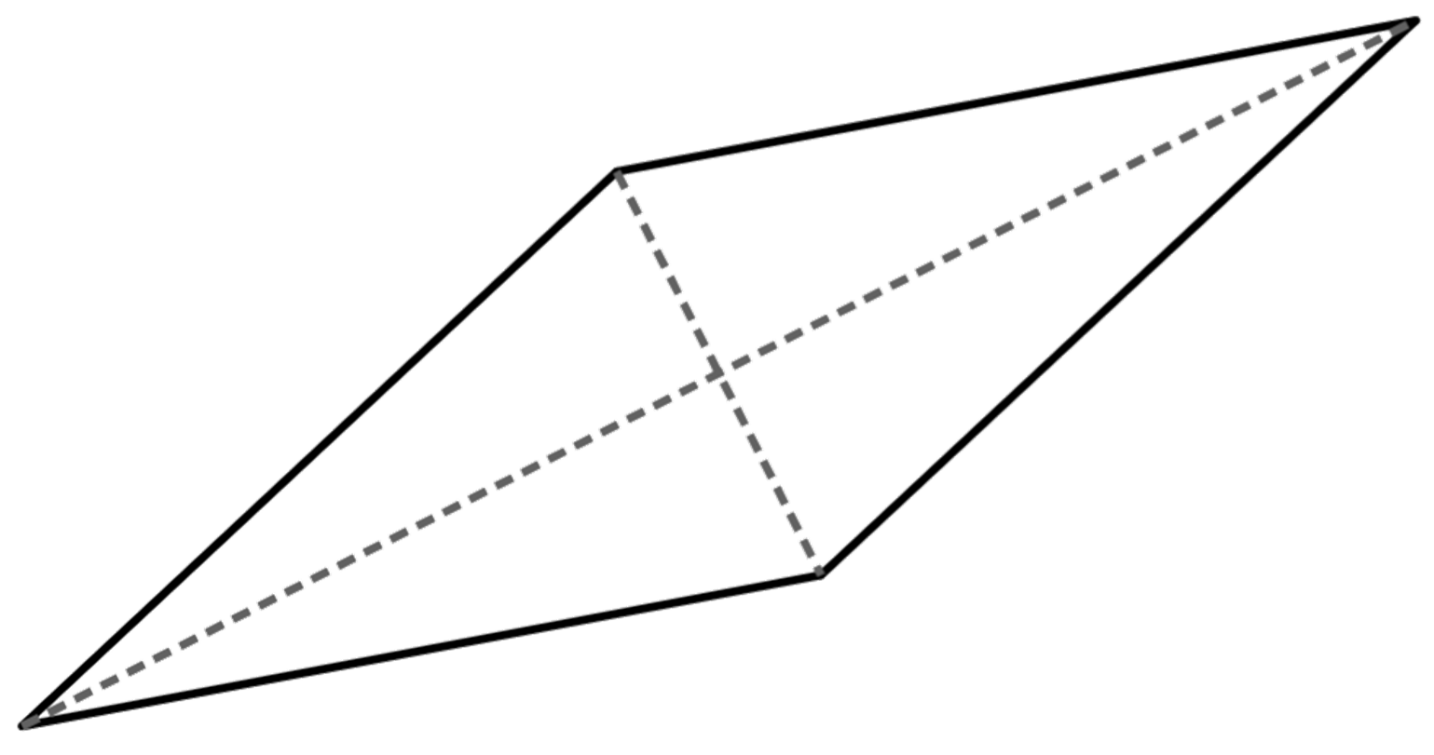
Justifying congruence by RHS
3) Using known facts about rhombi and their diagonals prove that triangle AED is congruent to BEC by RHS.
D
A
E
C
B

Slide 33
Justifying congruence by RHS
1) Use RHS to prove the following pairs of triangles are congruent.
a)
C
K
35 cm
0.35 m
12 cm
120 mm
A
M
B
L
∠ABC = ∠KLM = 90°
AC and KM are each triangle’s hypotenuse and are equal as 35 cm = 0.35 m
CB = KL as 12 cm = 120 mm, so triangle ABC and KLM are congruent by RHS.

Slide 34
Justifying congruence by RHS
1) Use RHS to prove the following pairs of triangles are congruent.
F
9 cm
O
b)
D
M
37°
12 cm
15 cm
53°
9 cm
15 cm
E
N
∠MON = 180 - (37 +53) = 90° = ∠EDF
EF and MN are each triangle’s hypotenuse and are equal.
DE = MO so triangle DEF and MNO are congruent by RHS.

Slide 35
Justifying congruence by RHS
2) Triangle TUV is isosceles, where TU = TV. TW is perpendicular to UV.
Prove triangles TUW and TWV are congruent by RHS.
T
∠TWU = ∠TWV as TW is perpendicular to UV.
TU = TV as triangle TUV is isosceles.
TW is a common side to both triangle TUW and TWV. So, triangles TUW and TWV are congruent by RHS.
U
V
W

Slide 36
Justifying congruence by RHS
3) By using known facts about rhombi and their diagonals prove that triangle AED is congruent to BEC by RHS.
∠AED = ∠BEC = 90° as the diagonals of a rhombus are perpendicular.
D
A
AD = BC as they are edges of a rhombus.
E
AE = EC as the diagonals of a rhombus bisect each other. So, triangle AED and BEC are congruent by RHS.
C
B

Slide 37
Congruent triangles (RHS)
For a right-angled triangle only, you can prove congruence by using the hypotenuse and one other side. This is known as RHS (right angle - hypotenuse - side).

Slide 38

© Oak National Academy 2024.
Produced in partnership with Mathematics in Education and Industry.
Licensed on the Open Government Licence v3.0, except where otherwise stated. See Oak terms and conditions.

